Slide 1
Frank Lloyd Wright
‘the interior space itself is the reality of the building”

Slide 2
Fallingwater 1935 - 1939

Slide 3
Robie House 1908 – 1909 Chicago

Slide 4
Imperial Hotel, Tokyo 1915 - 1922

Slide 5
Charles Ennis House 1923 – 24 L.A.

Slide 6
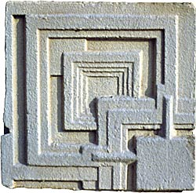
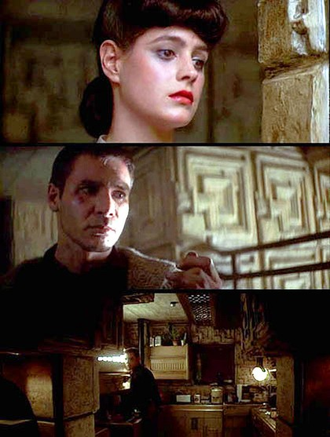
Inspiration – textile block houses

Slide 7
Johnson Building Wisconsin 1939

Slide 8
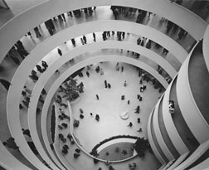
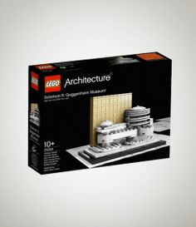
Guggenheim Museum, New York 1959

Slide 9
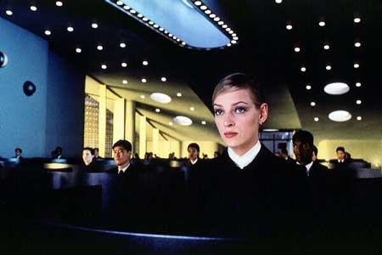
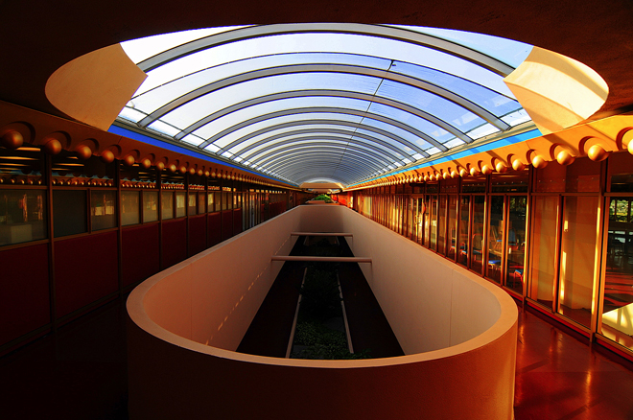
Marin County Civic Centre 1957 -1966

