Slide 1
Exhibition design thinking

Slide 2
Land people architecture exhibition

Slide 3
interaction

Slide 4
viewing

Slide 5
Connections links continuity

Slide 6
3D forms

Slide 7
Large scale

Slide 8
representational

Slide 11
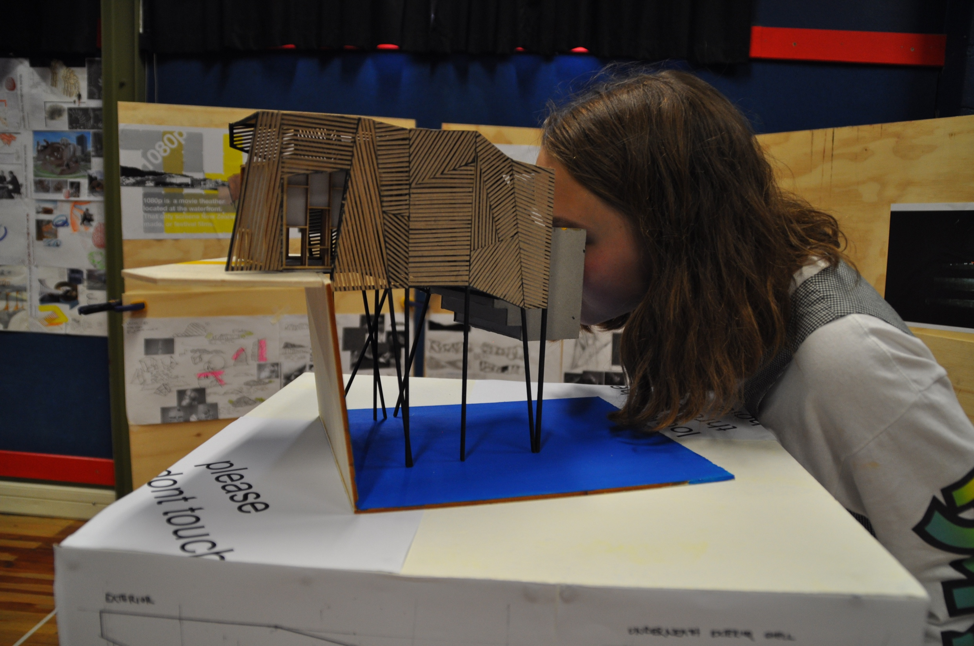

Slide 12
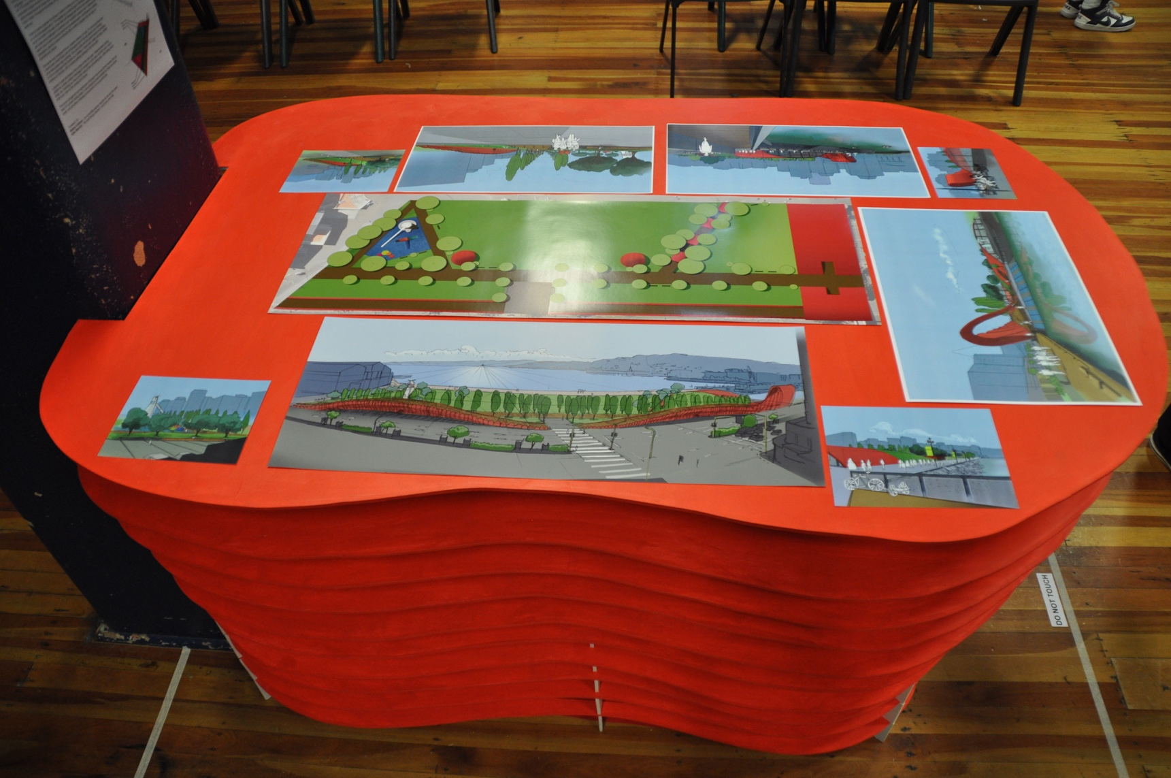
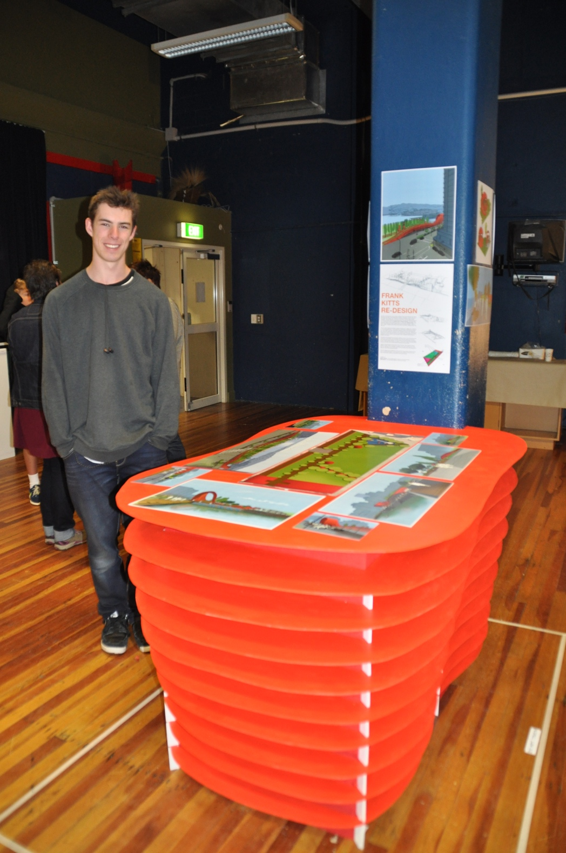

Slide 13
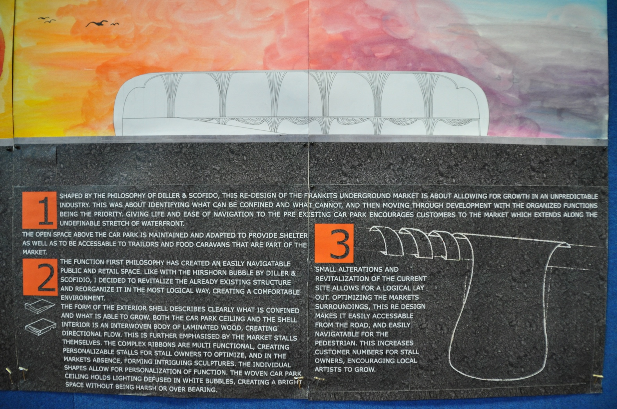
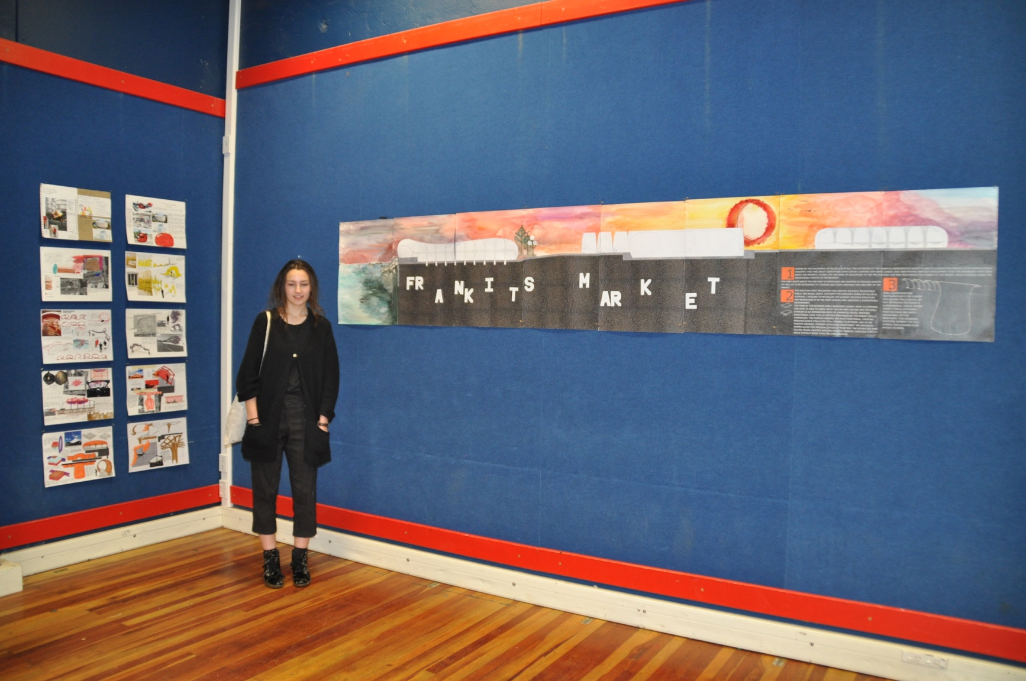

Slide 14
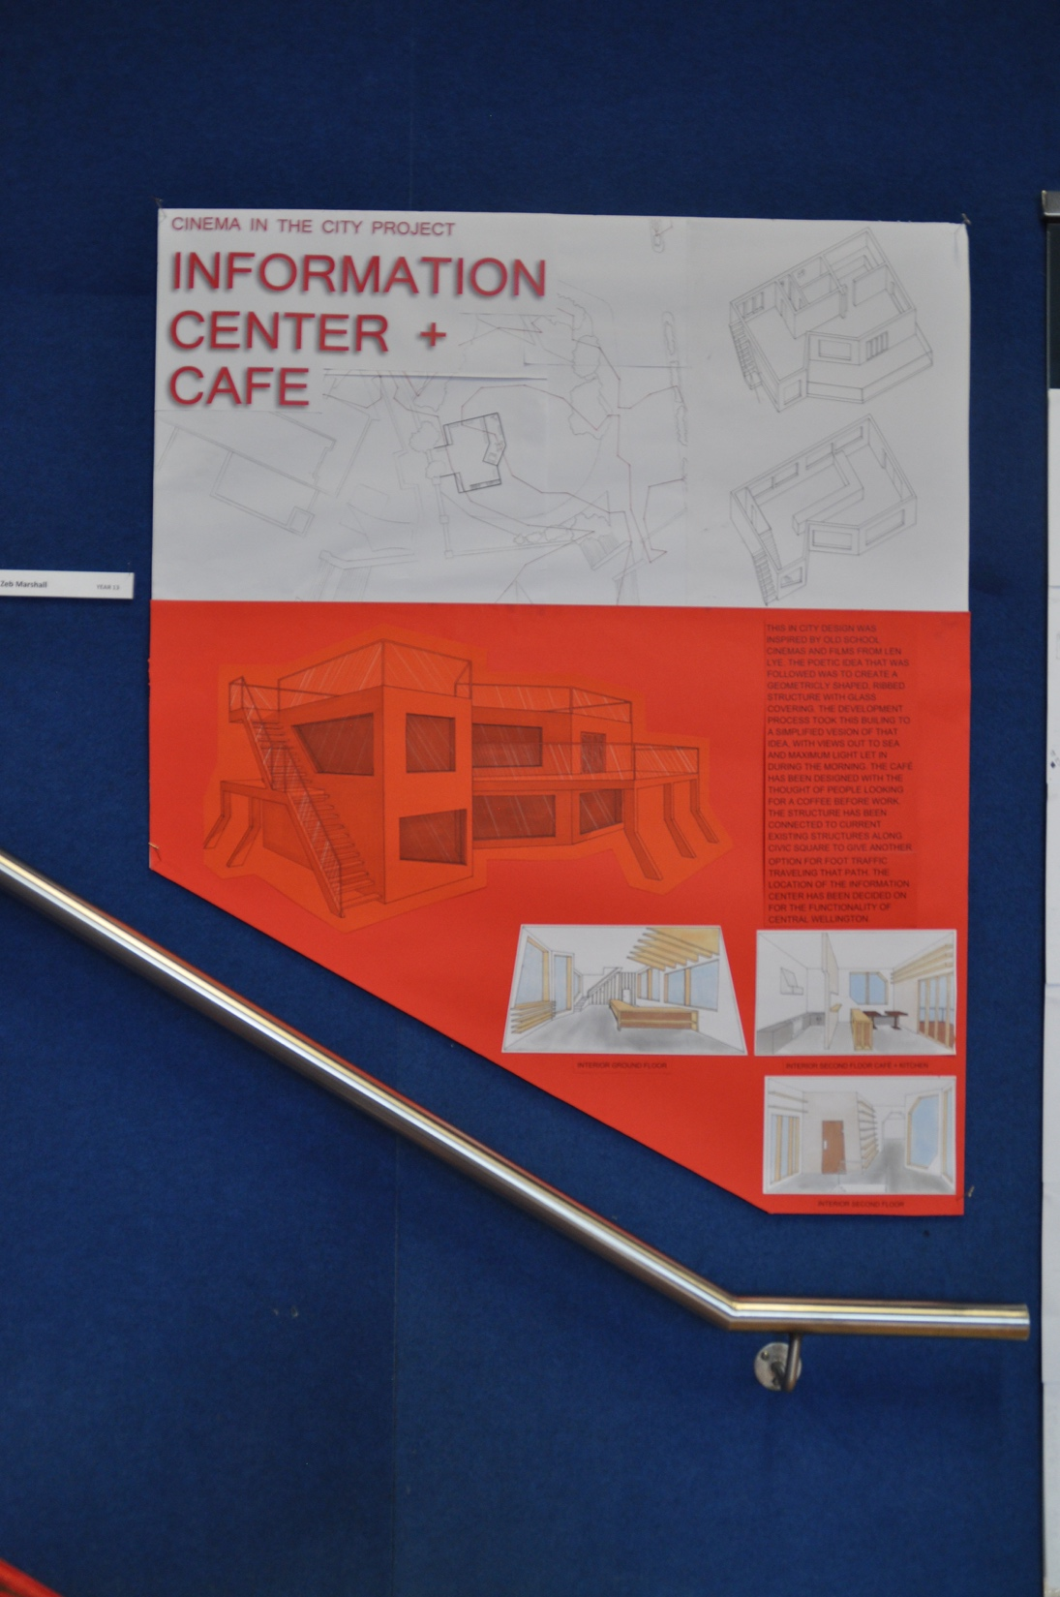
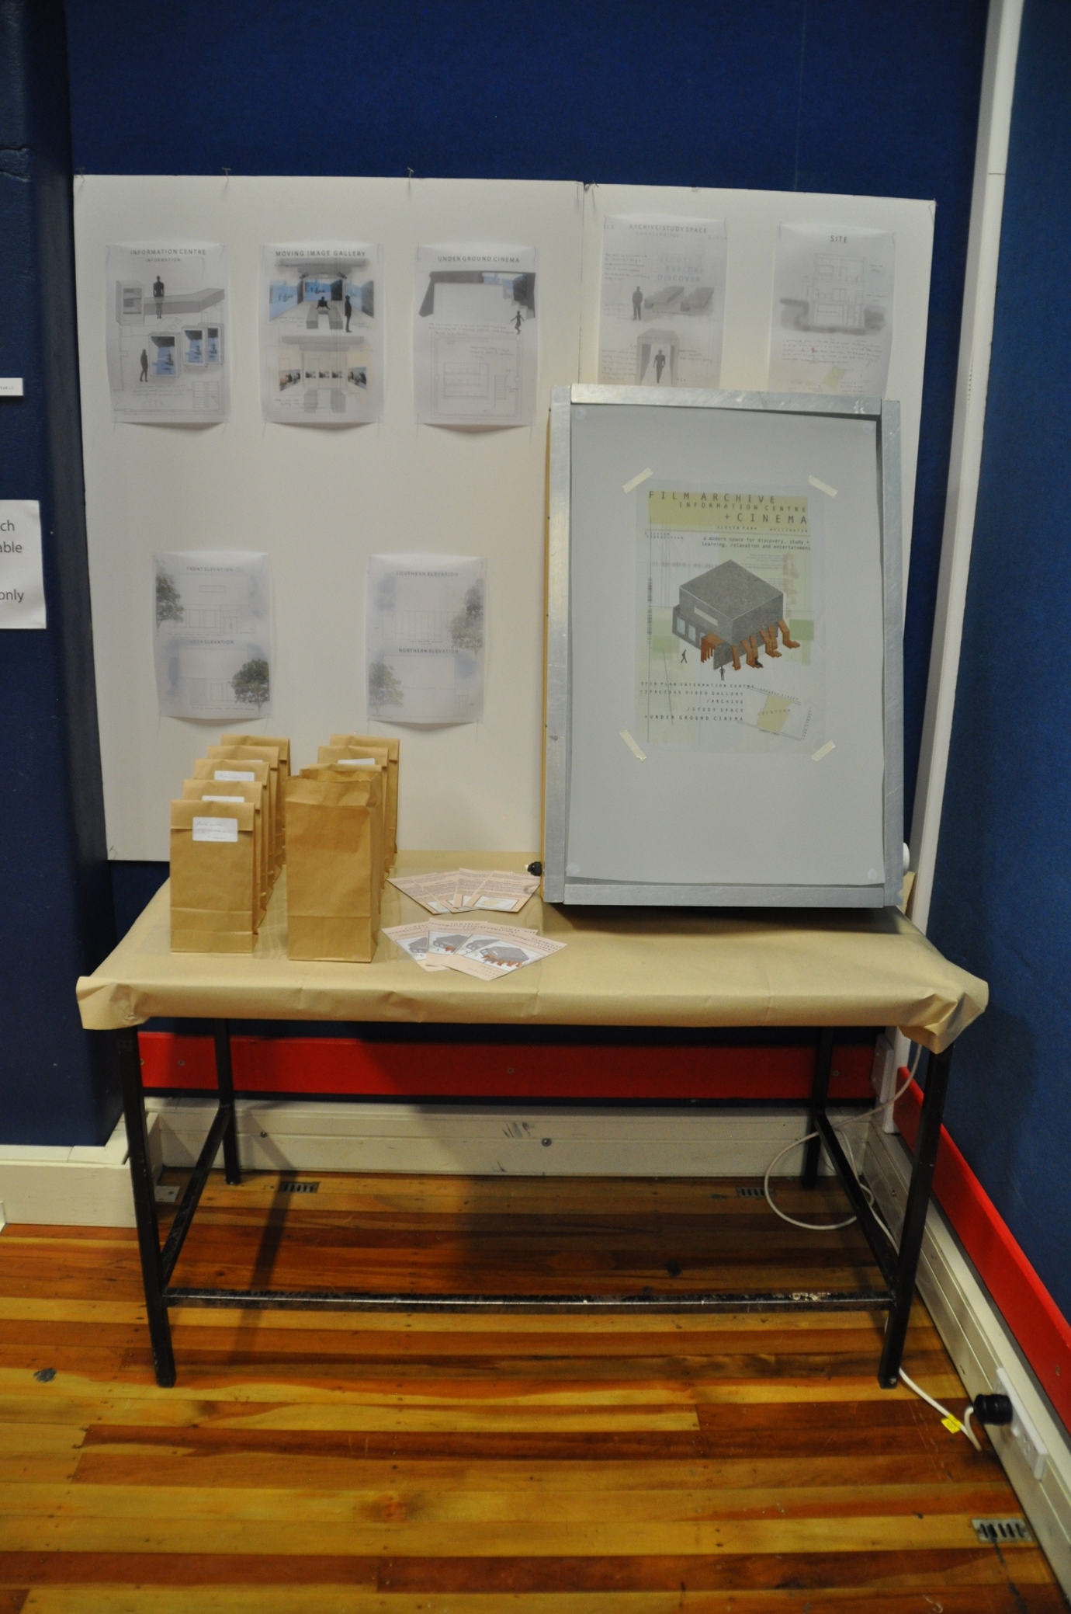

Slide 15
